Slide 1








SILVER SPONSOR
BRONZE SPONSORS
PARTNERS

Slide 2
What should you know about AI ACT if you are a AI practitioner
Marcin Szeliga

Slide 3
Agenda
Key principles
Risk-based approach
Obligations

Slide 4
Key principles

Slide 5
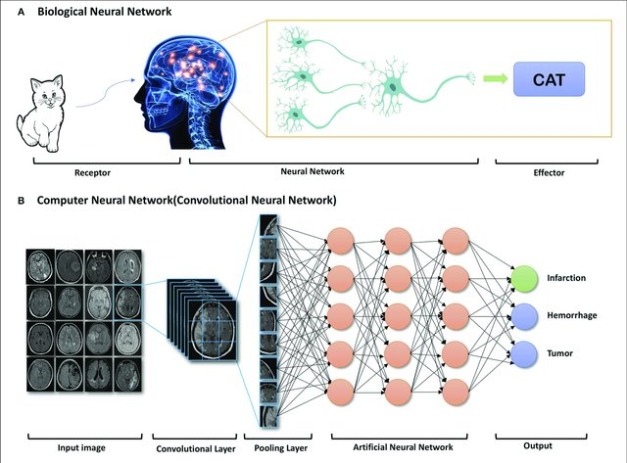
Artificial Intelligence
An AI system is a machine-based system that operates autonomously, may adopt after deployment, and generates outputs like predictions, content, recommendations, or decisions based on input, influencing physical or virtual environments (Article 3 (1))
Key characteristics include:
inference capability
learning and adaptiveness
autonomy
context of operation
Reprinted with permission from Zaharchuk et al. (15). Copyright American Journal of Neuroradiology

Slide 6

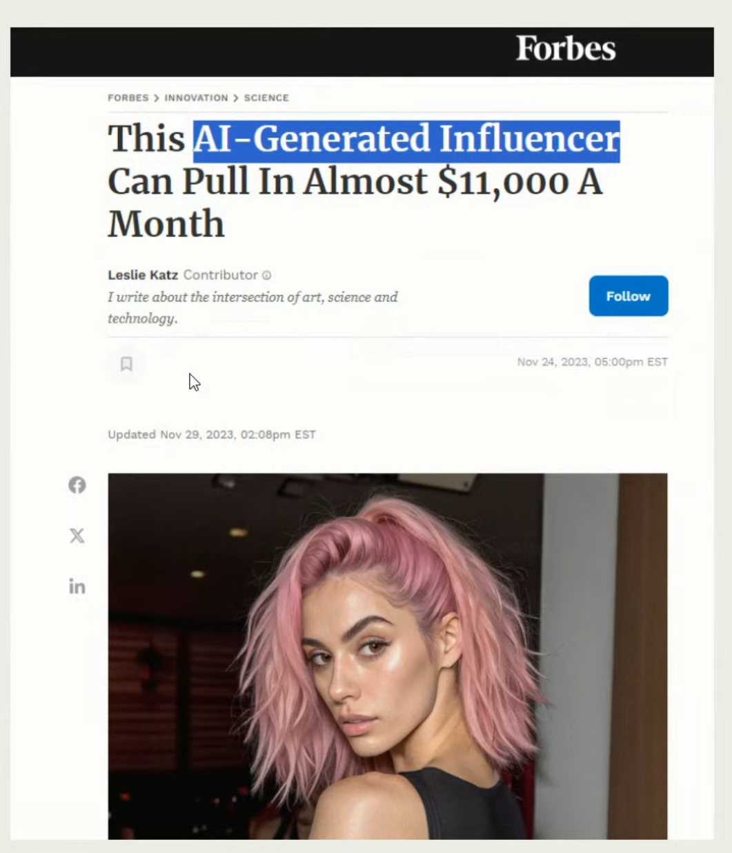
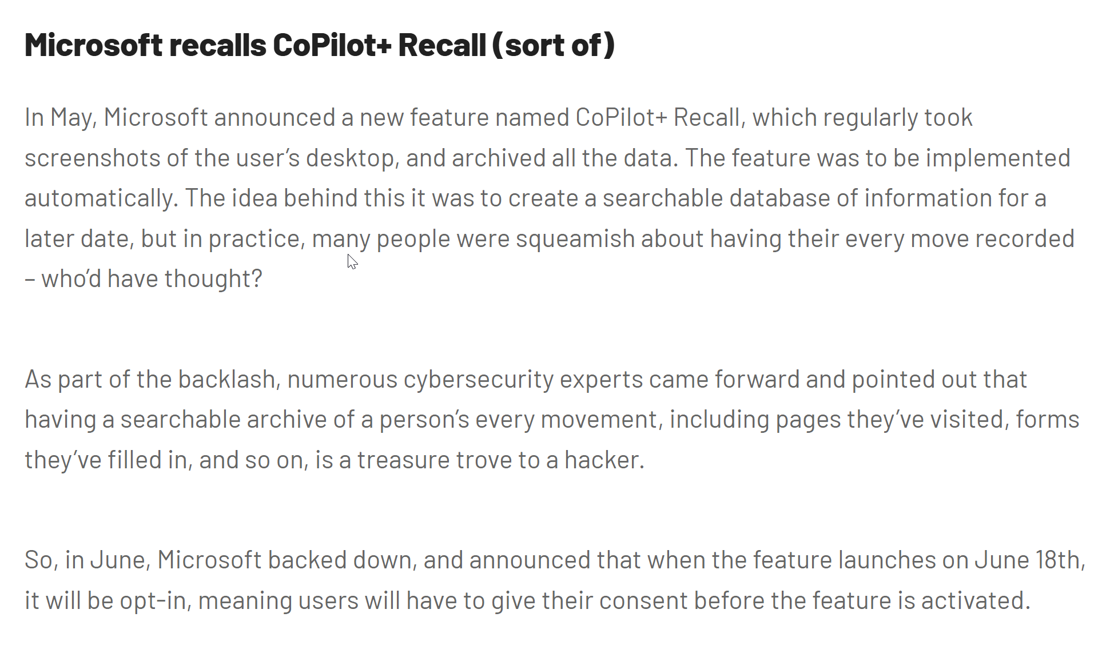
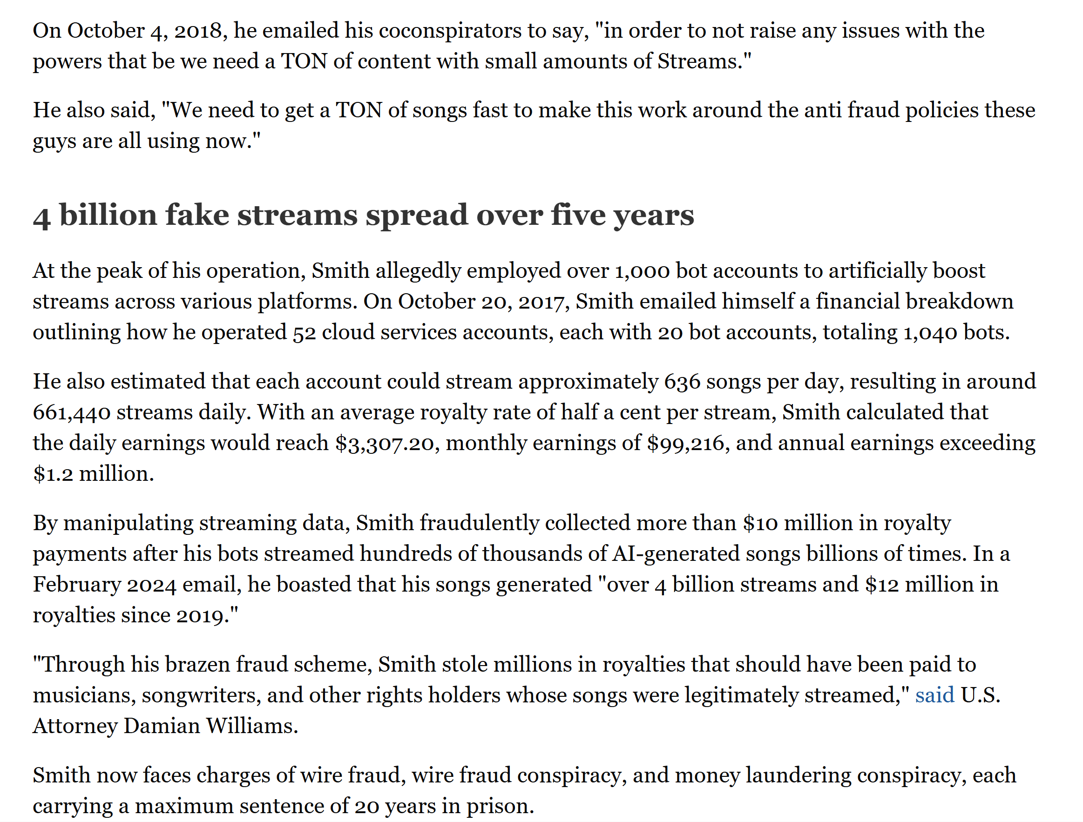
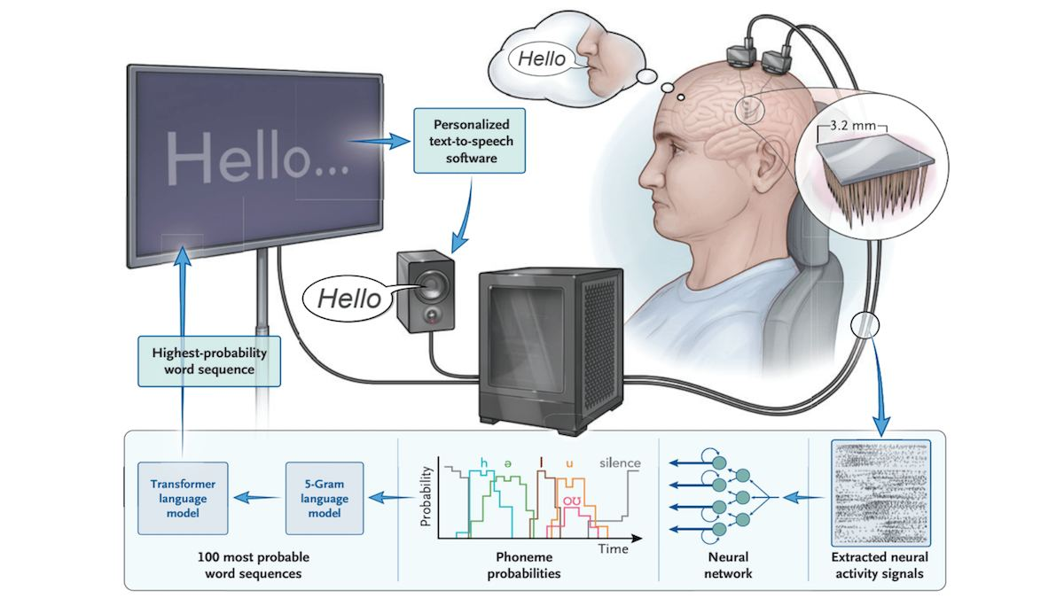
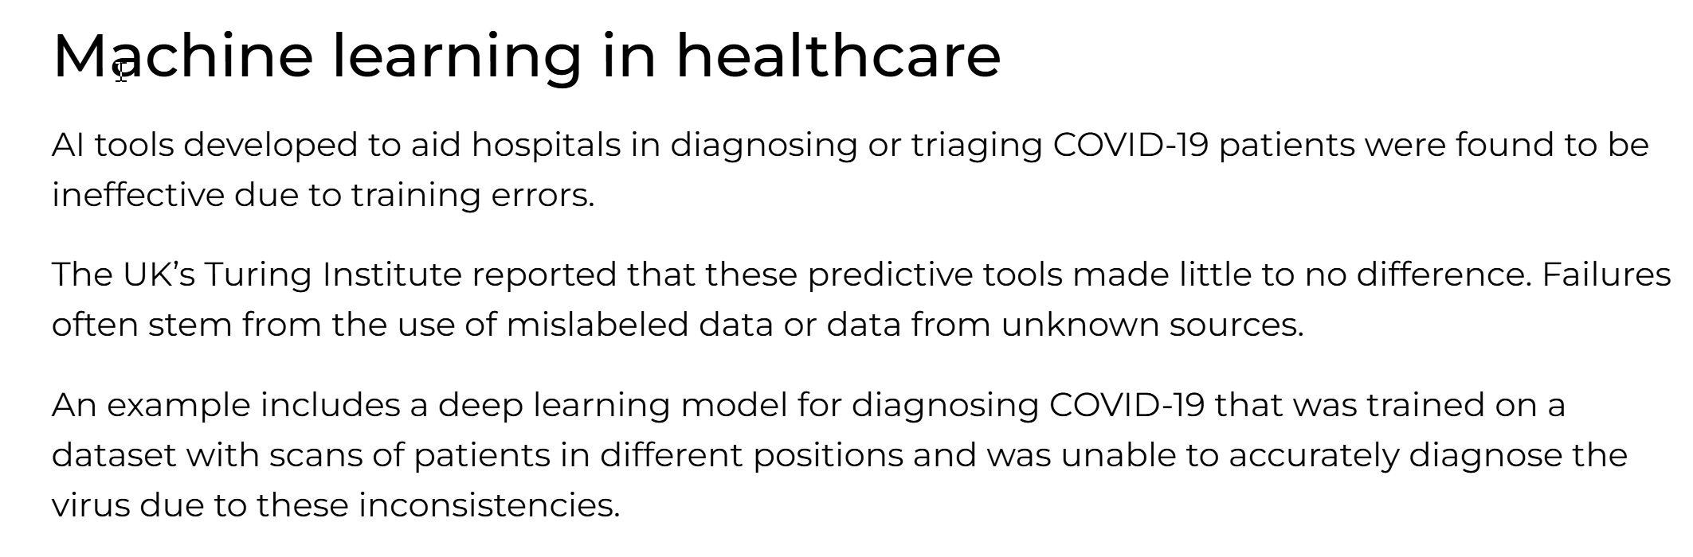
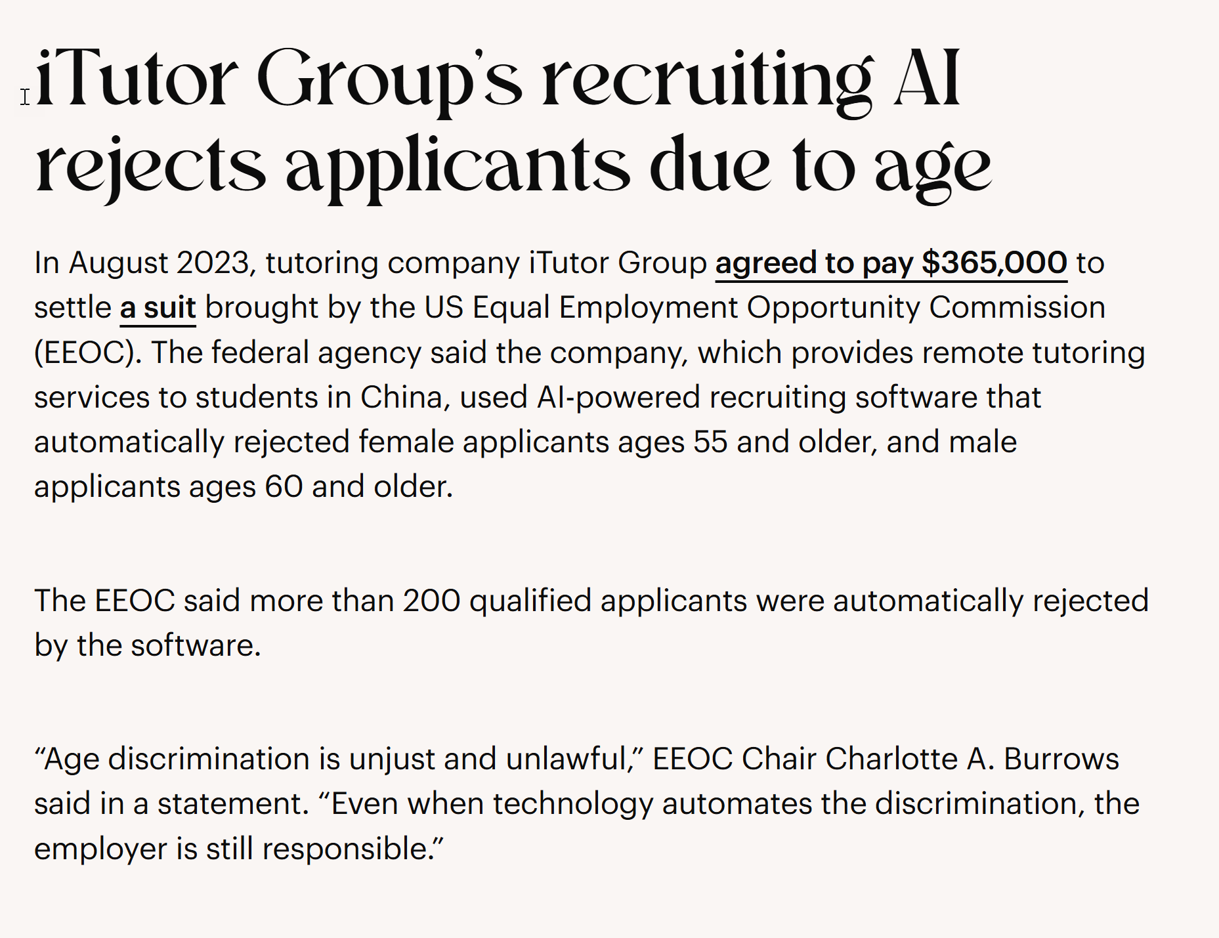
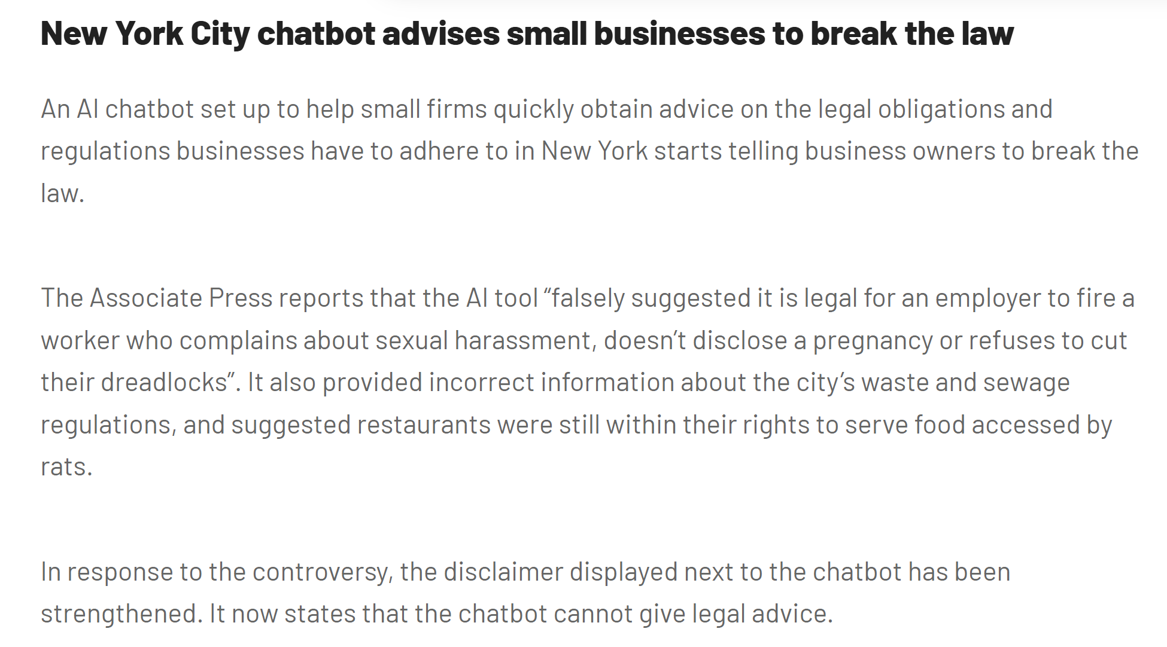
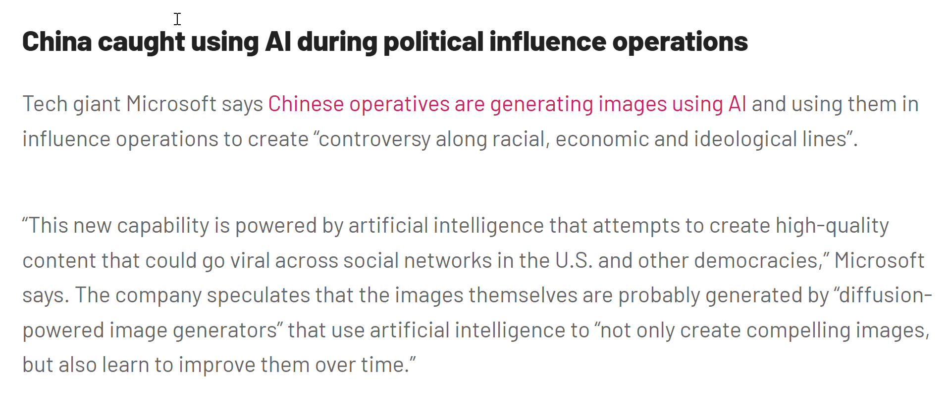
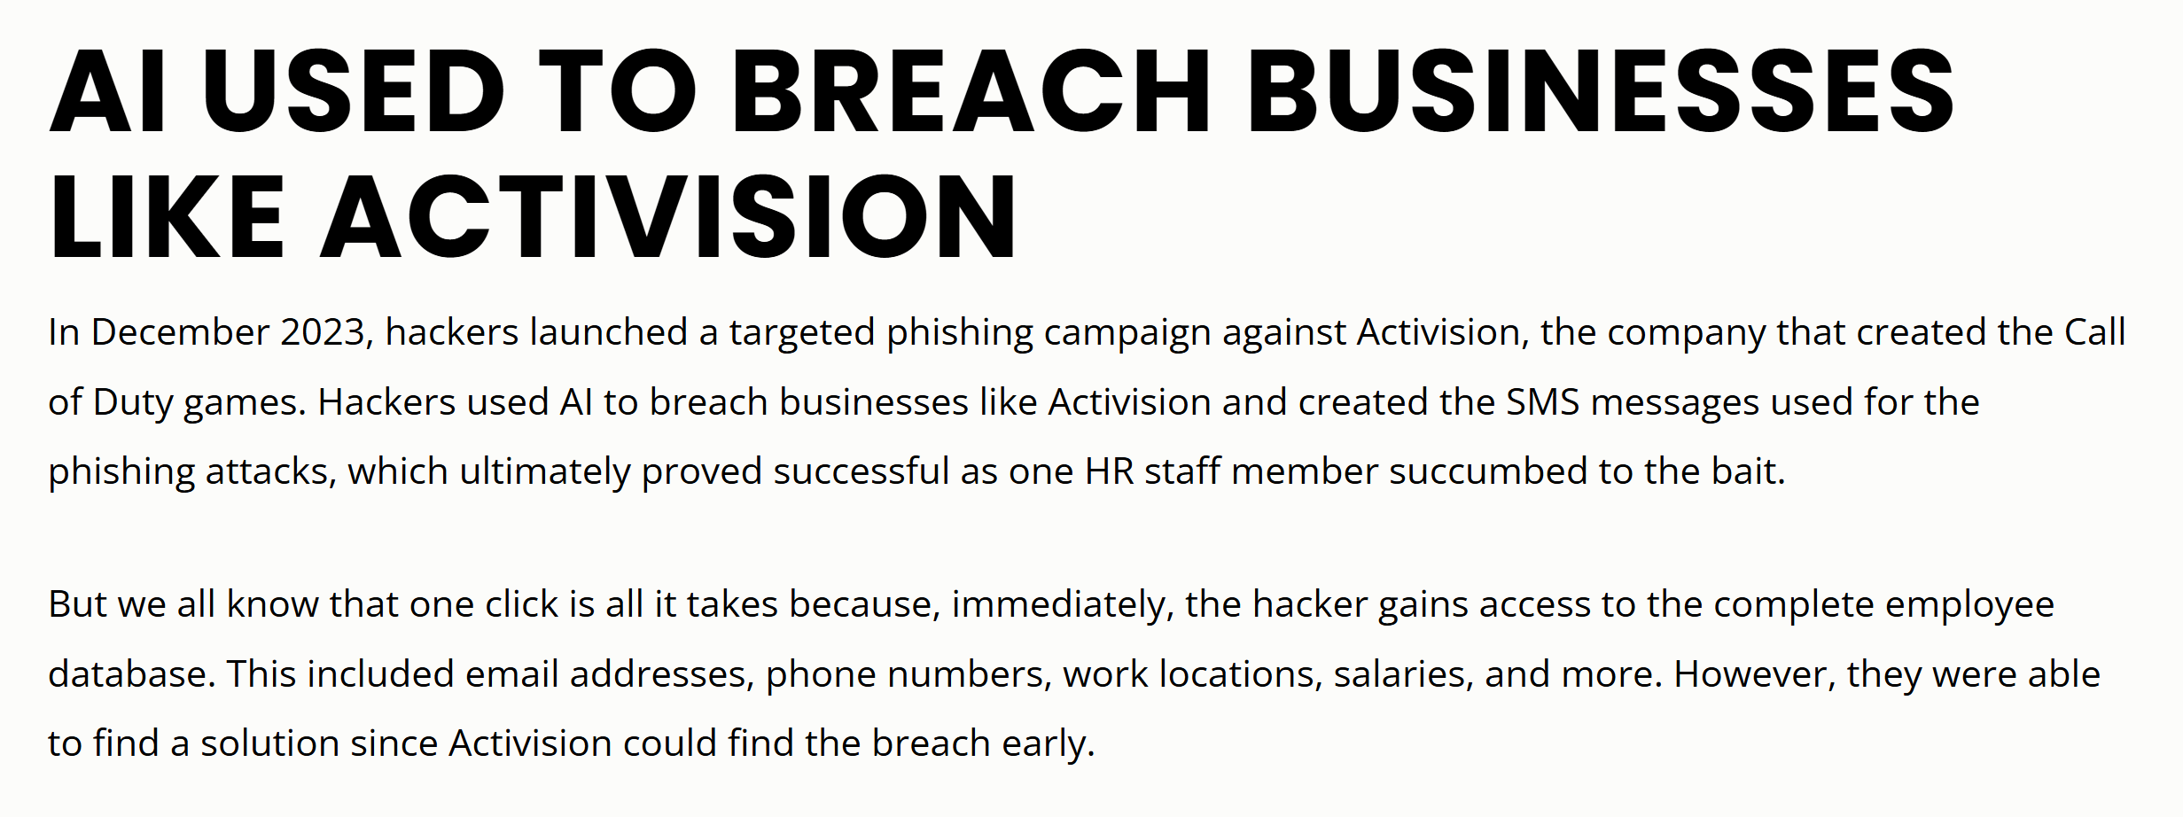
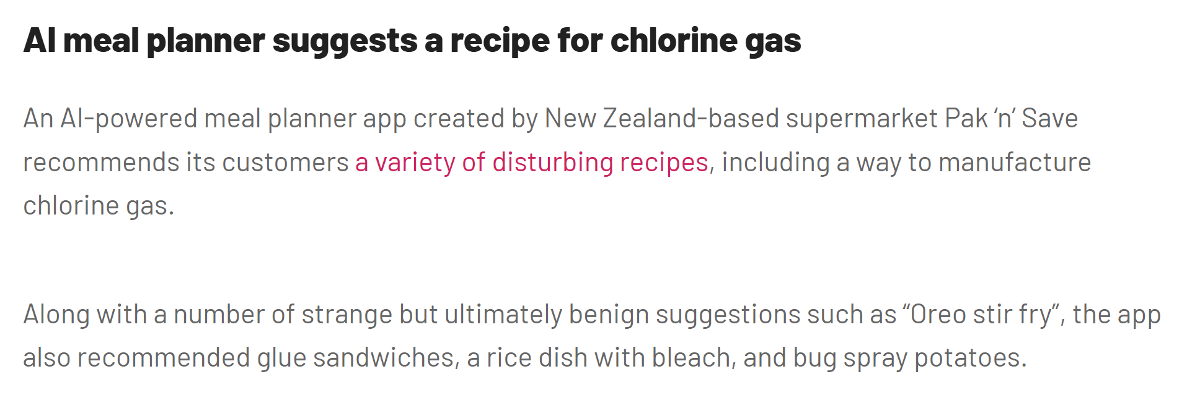
Technological progress holds value only when it benefits people and the natural environment

Slide 7


What do you think?
Yes
Should the use of AI be regulated by law?
No

Slide 8
The European Parliament believes that only sufficiently safe AI systems should be allowed for use, emphasizing prevention over regret
The regulation ensures that AI technologies:
Are used safely and ethically, respecting citizens’ rights, especially privacy and dignity
Are not used for mass surveillance or manipulation
Do not discriminate against users and operate impartially
Are controlled by humans, with users able to understand AI decision-making processes
Are safe, protecting users from potential system errors

Slide 9
Risk-based approach

Slide 10
Classification of AI systems based on the potential risks to public safety, fundamental rights, and societal values
Unacceptable risk (Article 5, Recitals 15-26)
This includes systems that manipulate human behaviour in harmful ways or violate privacy rights
High risk (Article 6, Recitals 27-40)
AI systems that negatively impact health, safety, fundamental rights, the environment, democracy or the rule of law
General purpose AI with systematic risk (Article 28)
GPAI systems are trained on large sets of diverse data, designed with the general nature of the results in mind, and can be adapted to a wide range of distinct tasks
Limited risk (Article 52, Recital 70)
A key condition for systems to be classified as limited risk is to ensure that they do not make final decisions without human review and approval.
Low risk (Article 69, Recital 81)

Slide 11
Eight systems with unacceptable risks
Subliminal manipulation
An AI system that uses subliminal audio messages in advertising to influence consumer behaviour without their conscious awareness
Exploitation of vulnerabilities
An AI-driven platform that targets individuals in extreme poverty with manipulative offers that exploit their financial desperation, leading them to make harmful financial decisions
Biometric categorization
An AI system that analyzes facial recognition data to infer an individual's political affiliations or religious beliefs
Social scoring
A social credit system that evaluates individuals based on their social media behavior and assigns scores that affect their access to services or opportunities

Slide 12
Eight systems with unacceptable risks cont.
Real-time remote biometric identification for law enforcement
AI systems used by law enforcement for real-time facial recognition in public spaces, potentially leading to mass surveillance and privacy violations
Risk assessment of natural persons
Predictive policing
Facial recognition databases
Untargeted web scraping of facial images
Emotion recognition in education & work
Assessment of the degree of satisfaction with work performed

Slide 13
High-risk systems: embedded AI
AI system governed by existing product safety laws
A product or a safety component of a product listed in Annex II:
Machinery directive
Directive on the safety of toys
Directive on recreational craft and personal watercraft
Directive on lifts and safety components for lifts
Directive on protective systems intended for use in potentially explosive atmospheres
Directive on radio equipment
Directive on pressure equipment
Regulation on cableway installations
Regulation on personal protective equipment
Regulation on appliances burning gaseous fuels
Regulation on medical devices
Regulation on in vitro diagnostic medical devices

Slide 14
High-risk systems: embedded AI
Annex II cont.
Regulation on common rules in the field of civil aviation security
Regulation on the approval and market surveillance of two- or three-wheel vehicles and quadricycles
Regulation on the approval and market surveillance of agricultural and forestry vehicles
Directive on marine equipment
Directive on the interoperability of the rail system within the European Union
Regulation on the approval and market surveillance of motor vehicles and their trailers, and of systems, components and separate technical units intended for such vehicles
Regulation on common rules in the field of civil aviation and establishing a European Union Aviation Safety Agency
Article 2.2 specifies that certain AI systems and practices are excluded from the scope of the regulation:
Military and defense purposes
Scientific research
Public authorities and international cooperation

Slide 15
High-risk systems: standalone AI
If any the following techniques, practices, or domains describe your AI system or its intended use:
Biometric identification
Critical infrastructure
Education
Employment
Essential private and public services
Law enforcement
Migration, asylum & border control
Administration of justice & democratic process
It’s high-risk system, unless …

Slide 16
AI systems that poses no significant risk
AI system is intended to perform a narrow procedural task
AI system is intended to improve the result of a previously completed human activity
AI system is intended to detect decision-making patterns or deviations from prior decision-making patterns and is not meant to replace or influence the previously completed human assessment, without proper human review
AI system is intended to perform a preparatory task to an assessment relevant for the purpose of the use cases listed in Annex III

Slide 17
GPAI with systematic risk
Article 28 defines general purpose AI (GPAI) systems as AI systems trained on large sets of diverse data, designed to produce general results, and that can be tailored to a wide range of distinct tasks
This implies that all assistant and agents that use large language models, as well as the models themselves, are GPAI
It also defines GPAI with systematic risk as systems that use models that require more than 10²⁵ floating-point operations per second (FLOPS) to train
This means that an assistant using the GPT-4 model is in the category of GPAI with systematic risk
The actual training of GPT-4 was done on approximately 25,000 NVIDIA A100 GPUs over 90-100 days, running at 32-36% utilization

Slide 18
Limited risk
Limited risk AI systems include those that are not classified as high-risk but still require certain transparency measures due to their potential impact on users
These systems are designed to interact with natural persons and include:
AI systems intended for interaction with individuals
Emotion recognition systems
Biometric categorization systems
Content generation systems

Slide 19
Low risk
Low-risk AI systems are those that do not fall into prevoius categories
These systems typically include applications that have minimal or no impact on individuals' rights and safety
Examples:
Spam filters
AI-enabled video games
Basic recommendation systems

Slide 20
EU AI Act Compliance Checker | EU Artificial Intelligence Act

Slide 21
Obligations

Slide 22
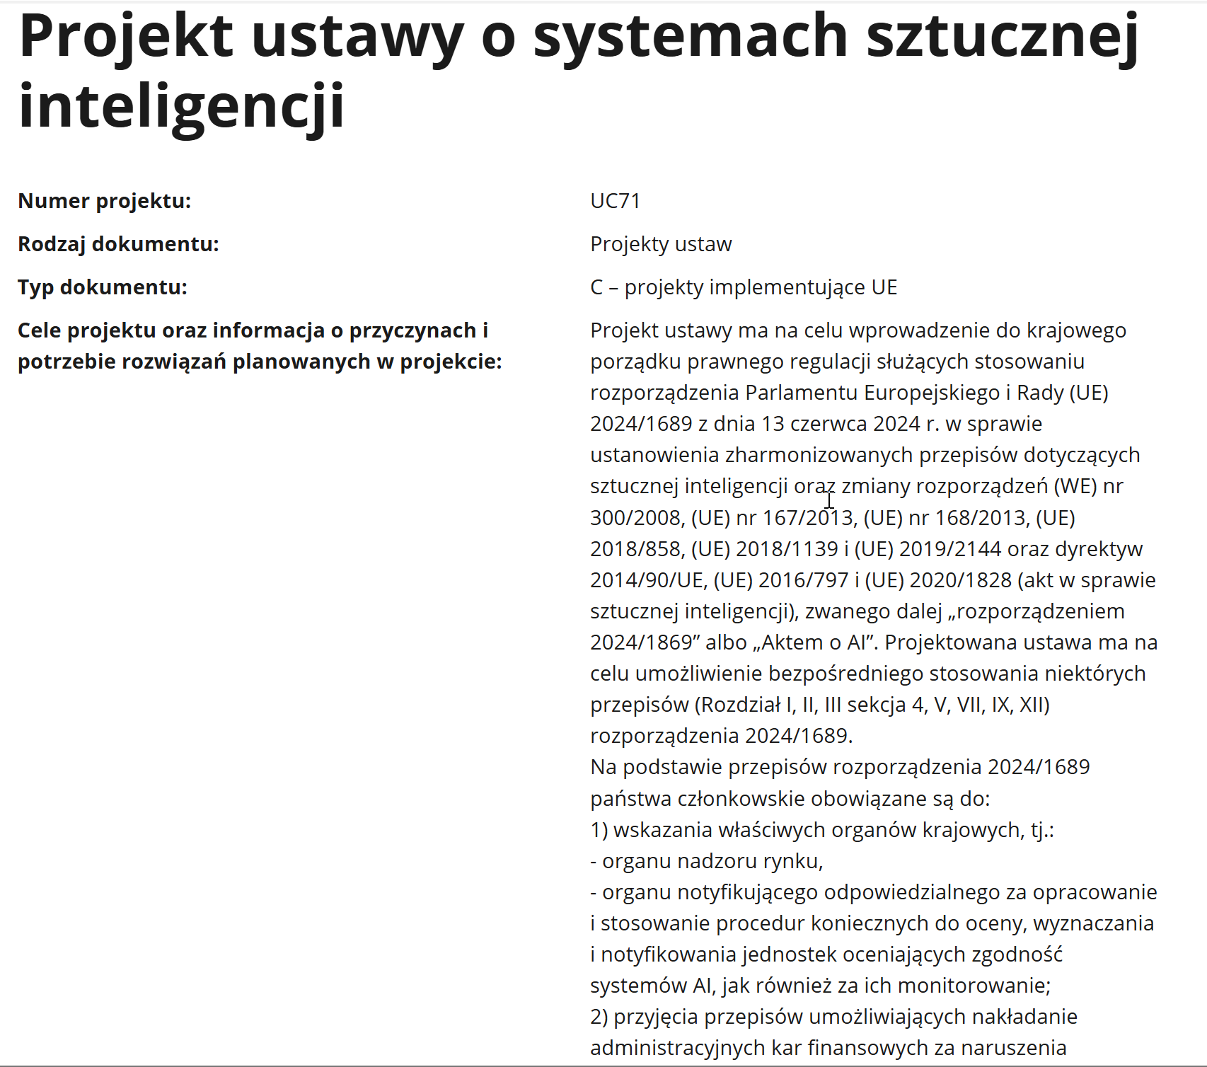
Scope of AI Act
The regulation applies to anyone using or sharing AI within the European Economic Area
Exceptions:
AI systems already covered by other EU harmonization legislation
AI systems used exclusively for military, defense, or national security purposes
AI systems intended solely for scientific research
AI systems used for private, non-commercial activities
AI systems released under free and open-source licenses
except where they fall under the prohibitions
except for the transparency requirements for GPAI

Slide 23
Legal obligations vary based on the organization’s role and the AI system’s risk class
A provider is a person or entity that develops an AI system or has it developed and places it on the EU market under their own name or trademark
A downstream provider is the provider of the AI ​​system that uses the AI ​​model, regardless of whether the model is provided by itself or by another entity under appropriate agreements
A deployer is a person or entity that uses an AI system under their authority, except when the AI system is used for personal, non-professional activities
The higher place in the chain, the higher the requirements
The higher the risk, the higher the requirements

Slide 24
Requirements for low and limited risk systems
Low-risk systems pose minimal risks and are not subject to formal regulations
Limited-risk systems are subject to transparency requirements to ensure users are aware they are interacting with AI

Slide 25
Transparency obligations
Disclosure of AI interaction
Users must be informed when they are interacting with an AI system, ensuring that the nature of the interaction is clear
Labeling of ai-generated content
Content generated by AI, including deepfakes, must be clearly labeled as artificial
Transparency in functioning
Providers of high-risk AI systems must ensure that these systems are designed to allow users to understand their functionality and decision-making processes

Slide 26
Requirements for GPAI systems
Providers of general-purpose models must:
Prepare documentation detailing the model’s operation and make it available to downstream providers
Ensure operational transparency, including using watermarks to identify generated content and complying with copyright regulations
Create a data management policy to ensure training data is collected and processed according to personal data protection regulations, and publish a description of the training data
For general-purpose models with systemic risk, providers must also:
Assess and identify potential risks, including impacts on fundamental rights and public health
Ensure security by making the model resilient to cyberattacks
Monitor the operation of GPAI models and report any incidents
Enable human oversight of the models’ operation

Slide 27
Requirements for high risk AI systems
Risk management (Article 9)
Data and data governance (Article 10)
Technical documentation (Article 11)
Record-keeping (Article 12)
Transparency and provision of information to users (Article 13)
Human oversight (Article 14)
Accuracy, robustness and cybersecurity (Article 15)

Slide 28
Requirements for providers of high risk AI systems
Implement a Quality Management System
Prepare technical documentation
Maintain operational logs
Perform a conformity assessment
Create an EU Declaration of conformity
Register the AI system in the EU database
Apply the CE marking
Monitor the market post-launch
Respond to incidents
Work with market surveillance authorities
Check if you have the capability to reach compliance

Slide 29
Requirements for deployers of high risk AI systems
Use the AI system as per the provided instructions
Assign human oversight and ensure proper training
Ensure data input is relevant and representative
Report serious incidents to the provider
Maintain operational logs
Cooperate with national competent authorities
Where applicable:
Conduct a data protection impact assessment
Conduct a fundamental rights impact assessment
Consider these options:
Establish an AI onboarding process with clear roles and responsibilities
Define a clear scope of the AI System usage
Manage the input data and logs
Train staff to detect and report incidents

Slide 30
Unacceptable risk AI systems
AI systems that conflict with EU values are banned
There is a six-month transition period for implementing the ban on prohibited AI practices (till February 2025)
Consider these options:
Cease support for the AI system (including development and usage)
Modify the AI system and its intended use to ensure it is not prohibited

Slide 31
Sanctions
Introducing a prohibited AI system can result in a fine of 35 million euro or 7% of the company’s global turnover from the previous year, whichever is higher
Failure to comply with other provisions of the regulation can lead to a fine of 15 million euro or 3% of the company’s global turnover from the previous year, whichever is higher
Not cooperating with enforcement bodies may incur a fine of 7 million euro or 1% of the company’s global turnover from the previous year, whichever is higher
In addition to financial penalties, entities may be required to take corrective actions to restore compliance with the regulation
In extreme cases, where violations significantly impact health, safety, or fundamental human rights, a ban on specific activities and the use of certain AI systems may be imposed

Slide 32
Perplexity

